Slide 1
Module No 5
Working Email & Microsoft Office 365 Activities Package

Slide 2
Learning Objective
Working with Emails – Different ways
Working Microsoft Office 365 Activities Package
SET UP AZURE & WORKING
Microsoft Office 365 activities

Slide 3
Method | Target /Protocol | Remarks
App Designation | Outlook
service specification | Microsoft365
 | Exchange
 | IBM Notes
protocol specification | IMAP
 | POP
 | SMTP
UI Operation | Any software | UI operation is a less stable process because you use clicks and keyboards to control your email software and webmail, so it is more likely to stop working due to changes in the software or web system.
 | Any webmail
Different Ways to send and receive email
There are several ways to send and receive email: application specific (Outlook), service specific (Microsoft365, Exchange, IBM Notes), protocol specific (IMAP, POP, SMTP), and UI manipulation (manipulate any software or webmail).

Slide 4
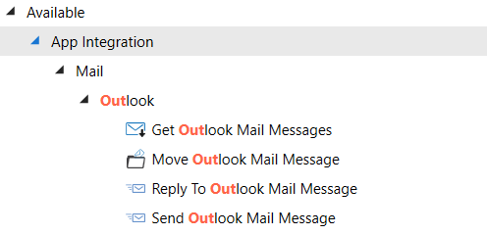
Outlook Email Activties
UiPath integrates Microsoft Outlook in UiPath Studio. This means there are activities integrated that help you with the email automation when you are using the Outlook application.
With the Outlook activity, you send emails using the account that is logged on, usually managed via the active directory.
With the Exchange activity, you can decide which account to use when sending emails.
There are few Other activities incase You wish to work With Gmail or Other Email provider which support IMAP.

Slide 5
Activity Name | Activity behavior
Get Outlook Mail Messages | Retrieve email messages from Outlook.
Move Outlook Mail Message | Moves Outlook email messages to the specified folder.
Send Outlook Mail Message | Send an email message from Outlook.
Save Outlook Mail Message | Saves your Outlook email messages in the specified folder.
Delete Outlook Mail Message | Deletes an Outlook email message.
Reply To Outlook Mail Message | Replies to an email message using Outlook.
Set Outlook Mail Categories | Assigns categories to a specified mail message.
Mark Outlook Mail As Read/Unread | Marks the specified mail message as read or unread.
Sending and receiving email using Outlook activities

Slide 6
Working with Microsoft Office 365
Microsoft announced that, effective October 1, 2022, They will begin to permanently disable Basic Authentication in Exchange Online in all tenants, regardless of usage, with the exception of SMTP Auth. as Basic Authentication is an outdated industry standard.

Slide 7
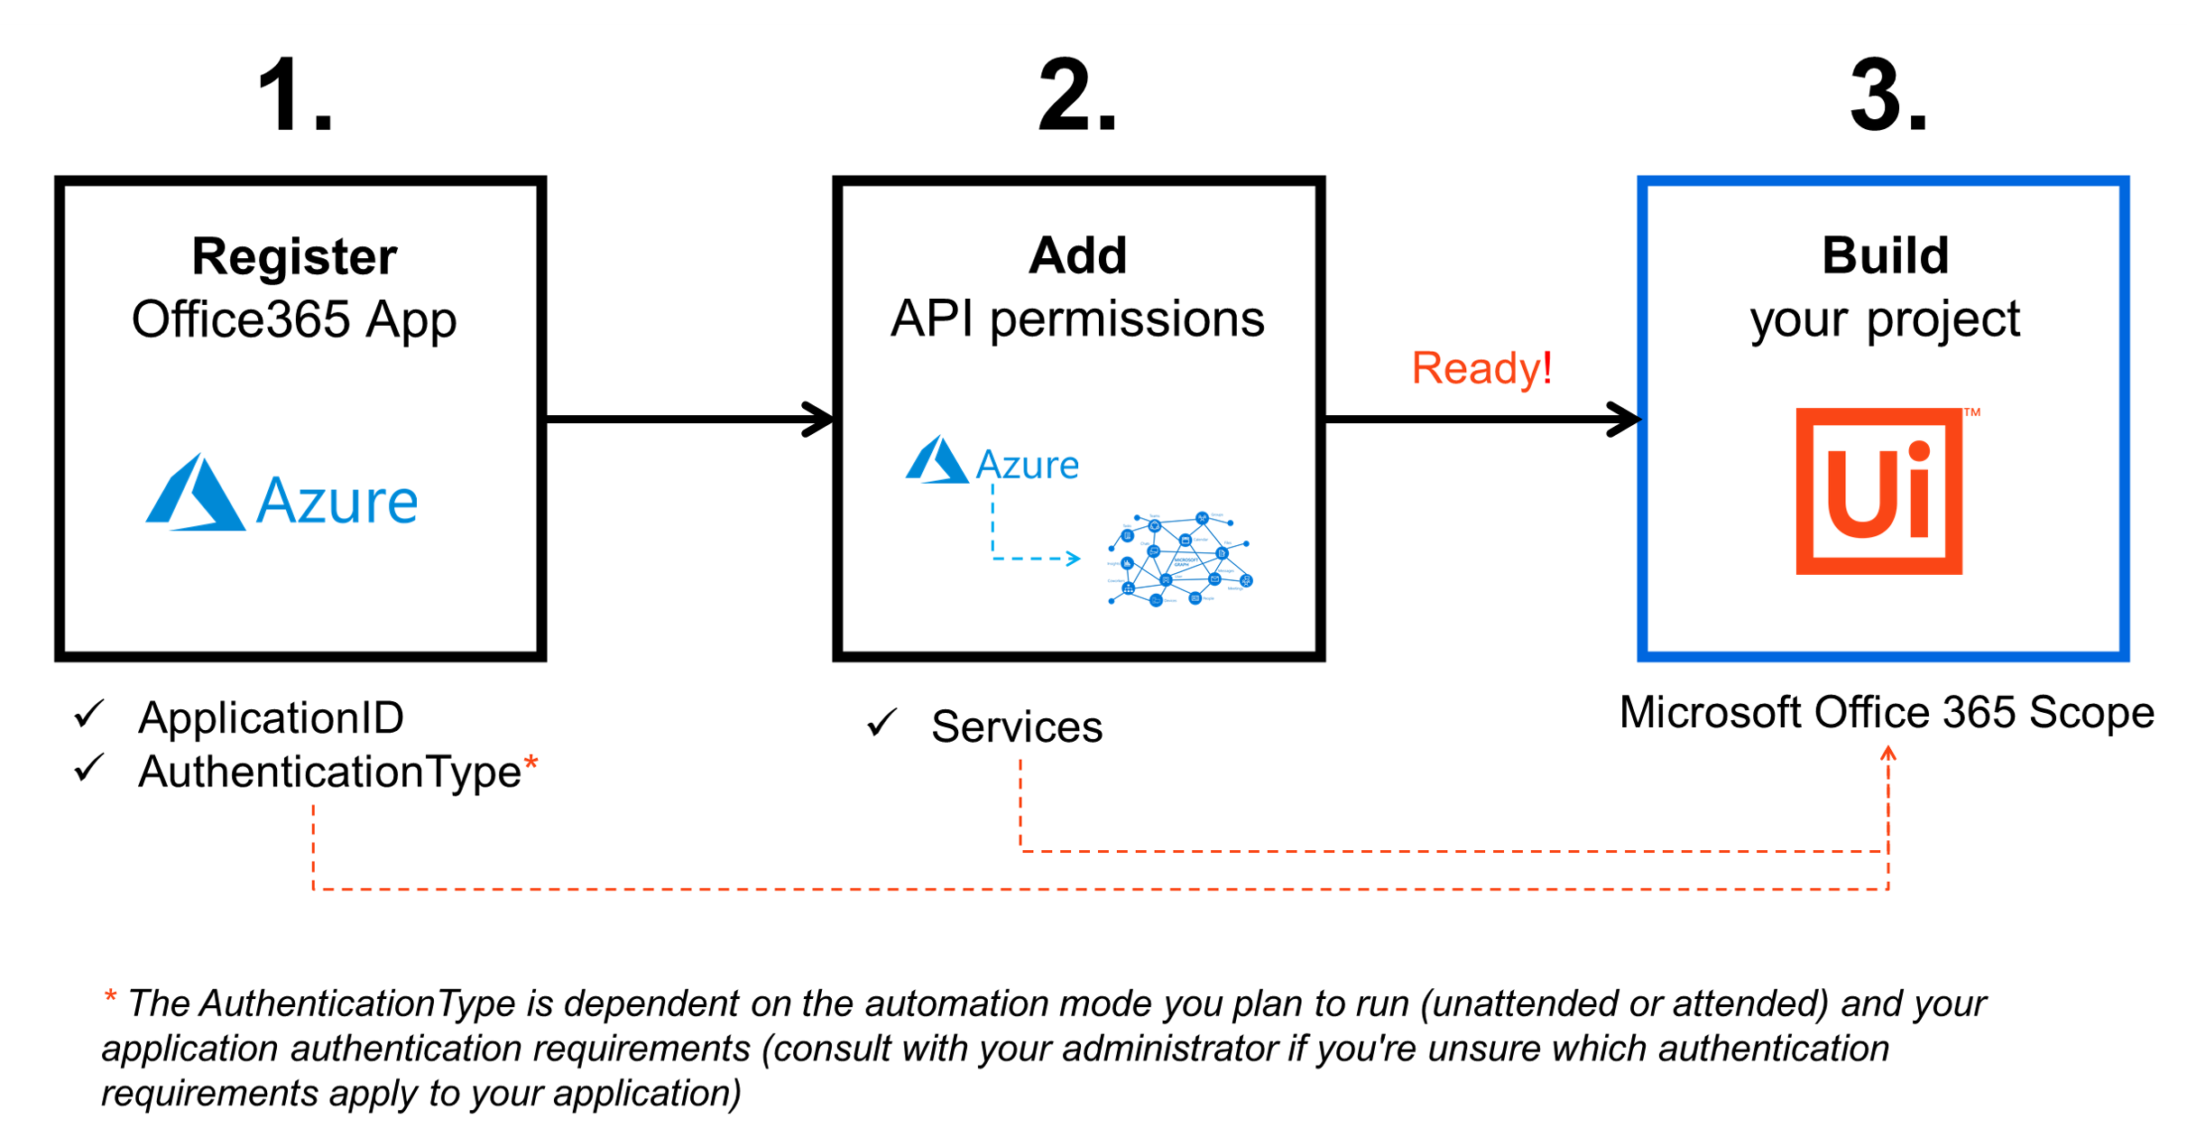
To enable the Microsoft Office 365 activities, your app must be integrated with the Microsoft identity platform and have the correct Microsoft Graph API permissions 2assigned to it. Please check the below thread and configure the same in your Organization

Slide 8
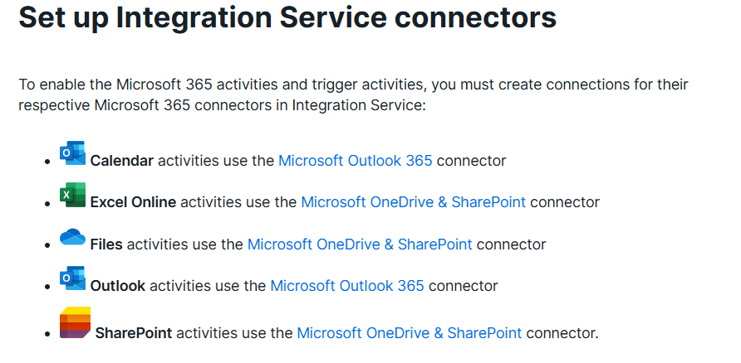

Slide 9
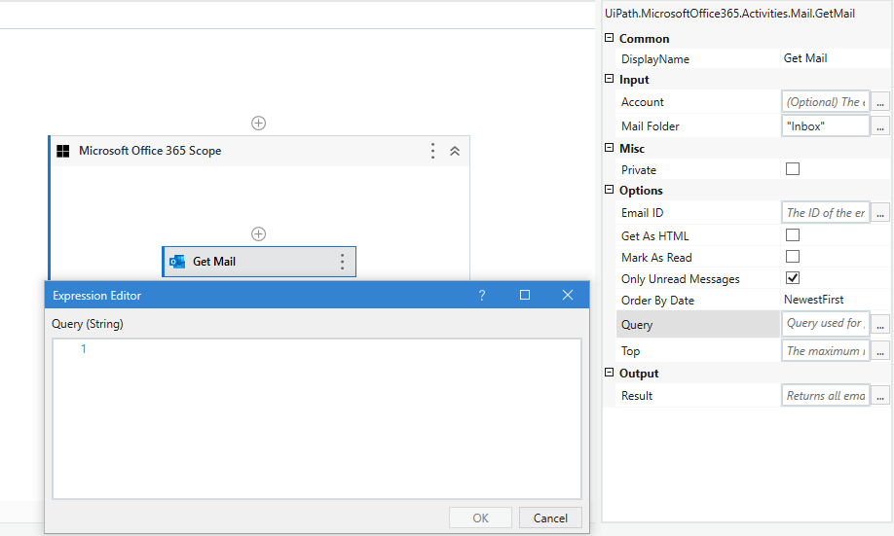
Microsoft Office 365 - Get Mail Activity Queries to filter returned emails
1. Get Emails with Subject contains particular text
"contains(subject, 'subject you are looking for')"
2. Get Emails with Subject Equals to particular text
"subject eq 'subject you are looking for'"
3. Get Emails with Subject starts with particular text
"startsWith(subject, 'subject you are looking for')"
4. Get Emails with Subject ends with particular text
"endsWith(subject, 'subject you are looking for')"
5. Get Emails with Body contains particular text
"contains(body/content, 'body you are looking for')"
6. Get Emails with Body Equals to particular text
"Body eq 'body you are looking for'"
7. Get Emails with Body starts with particular text
"startsWith(body/content, 'body you are looking for')"
8. Get Emails with Body ends with particular text
"endsWith(body/content, 'body you are looking for')"
9. Get Emails from specific recipients
"contains(from/emailAddress/address, 'EmailID')"
10. Get Emails if received date is greather than particular date
"receivedDateTime gt yyyy-MM-dd"
Thanks, Lakshman, for consolidated list - https://forum.uipath.com/t/microsoft-office-365-get-mail-activity-queries-to-filter-returned-emails/482645/1

Slide 10
Gmail Automation

Slide 11
https://docs.uipath.com/activities/docs/office365-setup
https://docs.uipath.com/activities/docs/microsoft-office-365-scope

